Slide 1
Arithmetic & Fractions (Q-1)
Rupom Bhattacharjee
Mentor
GRE Crash Course
Organized By SUSTCC

Slide 2
Lecture Outline
Facts about number
Absolute value
Rounding decimals
Converting fractions to decimals
Comparing fractions

Slide 3

Let’s Begin with a Problem
x is a non-zero real number;
x≠1 ;
A | B
$$x^{2}$$ | $$x^{4}$$
Notes:
Ans: D

Slide 4
Some Quick Facts
A number could be any number on the number line
Zero is the only number that is neither positive nor negative
Integers include all positive and negative whole numbers

Slide 5

Absolute Value
Distance of the number from the origin
⃒ x+3⃒ is the distance of x from -3
$⃒ x ⃒=x$, when x is positive or zero
$⃒ x ⃒=−x$, when x is negative

Slide 6
Absolute Value
Think yourself
⃒x-1⃒>4; what does it say about the value of x ?
Notes:
Ans: X>5 and X<-3

Slide 7

Absolute Value: Practice Problem
Consider the positive integers from 1-100. If n is a number in that set, then for how many numbers n is it true that
$$⃒n−30 ⃒> 20 ?$$
Notes:
Ans: 59

Slide 8
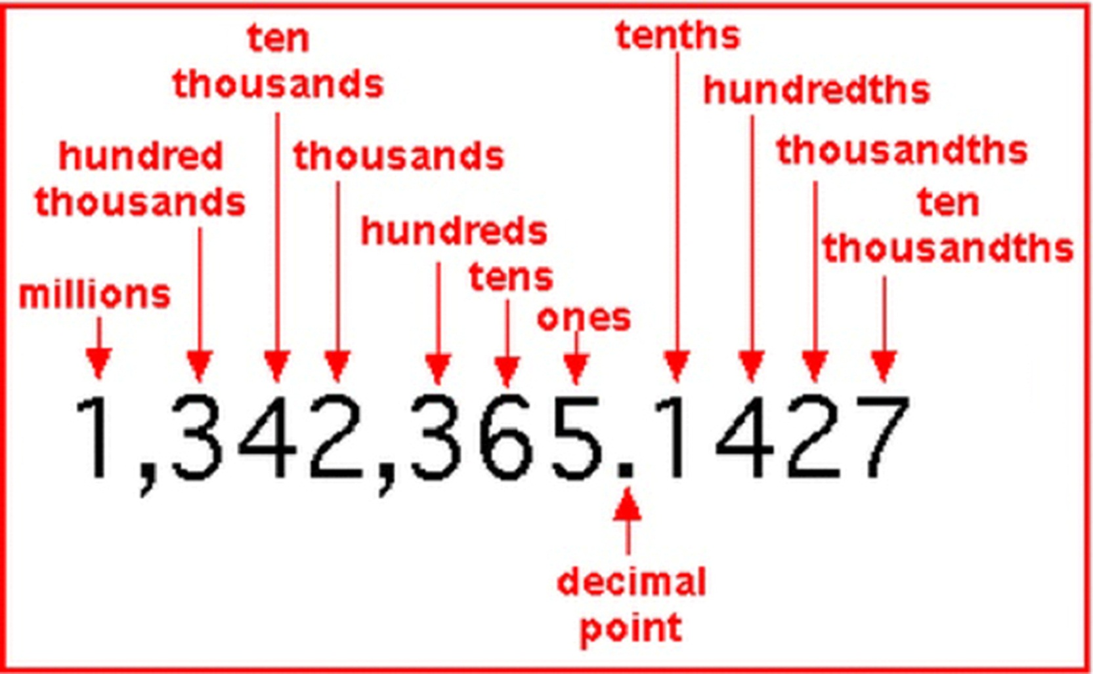
Decimal- Place Value

Slide 9
Rounding Decimals: The Rules
If the digit next to the desired place is from 1 to 4, we will round down
If it’s from 5 to 9 we will round up
7.49 = 7 ( rounded to nearest integer)
7.5696 = ? ( round it to the nearest thousandths)
Notes:
7.5700

Slide 10
Practice Problem
59,049 rounded to nearest hundred place ?
Notes:
Ans: 59000

Slide 11
Fraction to Decimal Conversion

Slide 12
Some Conversions You Must Memorize
Fraction | Decimal | Fraction | Decimal
1/2 | 0.5 | 1/9 | 0.111
1/3 | 0.333 | 1/10 | 0.1
1/4 | 0.25 | 1/11 | 0.09
1/5 | 0.2
1/6 | 0.167 | 3/4 | 0.75
1/7 | 0.143 | 5/6 | 0.8333
1/8 | 0.125 | 3/8 | 0.375

Slide 13
Fraction to Decimal Conversion
Practice: 1/600 9/11 5/9
Notes:
.00167
.81
.555

Slide 14

Fraction to Decimal Conversion: Practice
The value of $\frac{(1.3333)(0.6666)(1.125)}{(0.75)(0.8)(0.8333)}$ is closest to 1/2 2/3 3/2 2 3
Notes:
D.

Slide 15
Comparing Fractions

Slide 16

Let’s Begin With a Problem
A | B
$$4/5$$ | $$7/8$$
Notes:
Ans: B>A

Slide 17

Let’s See Another
A | B
$$\frac{34105}{7251\text{6}}$$ | $$\frac{34107}{7251\text{8}}$$
Notes:
Ans: B>A

Slide 18
Comparing Fractions: Big Ideas
Bigger numerator makes the fraction bigger
2/5 > 1/5
Bigger denominator makes the fraction smaller
2/6 < 2/5

Slide 19
Comparing Fractions: Big Ideas
If we add the same number to the numerator and the denominator, then the resulting fraction will be much closer to 1 than the original fraction.
If 1 > original fraction, resulting fraction > original fraction and vice versa
2/5 ?? 5/8
5/2 ?? 7/4

Slide 20

Comparing Fractions: Adding two different numbers
If 2/3 is bigger than a/b, then $\frac{a+2}{b+3}$ will be larger than $\frac{a}{b}$
If 2/3 is smaller than a/b, then $\frac{a+2}{b+3}$ will be smaller than $\frac{a}{b}$
$\frac{316}{720}$ < $\frac{320}{723}$
Notes:
If 2/3 is added, then if 2/3 is greater than the original fraction, then the resulting fraction will also be greater than the original fraction.

Slide 21
Practice Problems

Slide 22

Practice Problem
At a certain school in December 2013, there were six teachers and 200 students. On January 2nd, the day after new-year, one teacher and 35 students joined the school, and no one left the school.
A | B
The teacher-student ratio in 2013 | $$\text{The} \text{teacher}\text{−}\text{student} \text{ratio} \text{in} \text{late} \text{January}\text{, 2014.}$$
Notes:
Ans: A>B

Slide 23
Practice Problem
Set K consists of all fractions of the form x/(x+2) where x is a positive even integer less than 20. What is the product of all the fractions in Set K ? A. 1/20 B. 1/10 C. 1/9 D. 1/2 E. 8/9
Notes:
Ans: B

Slide 24
Practice Problem
If x > 21/40, then x could be which of the following? Indicate all possible values of x. A. ​ 1/2 B. 11/20 C. 13/25 D. 19/36
E. 31/60
F. 38/75
G. 41/80
Notes:
Ans: B,D

Slide 25

Practice Problem
A | B
The product of integers from -87 to -36 inclusive. | $$\text{The} \text{product} \text{of} \text{integers} \text{from}\text{ −58 }\text{to}\text{ −34 }\text{inclusive}$$
Notes:
Ans: A

Slide 26
Practice Problem
If a, b, c and d are different integers between -6 and 10 inclusive, what is the least possible value of the product abcd? A. ​-480 B. -720 C. -1200 D. -3600 -4320
Notes:
Ans: B,D

Slide 27

Practice Problem
A | B
$$\frac{213}{428}+\frac{3007}{9101}$$ | $$\frac{741}{1462}+\frac{208}{597}$$
Notes:
Ans: B

Slide 28

Practice Problem
A | B
$$641,713∗451,222$$ | $$897,189∗318,977$$
Notes:
Ans: A

Slide 29

For a certain event, 148 people attended. If all 148 had paid full admission price, the total revenue would be three times the cost of sponsoring the event. (Admission price was the only source of revenue.) As it happens, only 50 paid the full admission price, and the others paid nothing.
A | B
The total revenue | $$\text{T}\text{he} \text{cost} \text{of} \text{sponsoring} \text{the} \text{event}$$
Notes:
Ans: A

Slide 30

Practice Problem
The decimal r = 2.666666 continues forever in that repeating decimal pattern. When written as a fraction in lowest terms, r = a/b, where a and b are positive numbers.
A | B
a+b | $$\text{10}$$
Notes:
Ans: A

Slide 31
Having received his weekly allowance, John spent 3/5 of his allowance at the arcade. The next day he spent one third of his remaining allowance at the toy store, and then spent his last $0.80 at the candy store. What is John’s weekly allowance? ​$ 2.40 $ 3.00 $ 3.20
D. $ 3.60
E. $ 4.80
Notes:
Ans: B

Slide 32
Thank You

